Slide 1








Jane Wamuyu Kenda
Decision Support Team (Team 18)
12/16/2025
Optimizing University Outreach Campaigns to Improve
Enrollment Outcomes
Using outreach data to identify engagement and conversion levers that drive a 15% improvement in enrollment outcomes.
Next

Slide 2











BUSINESS CONTEXT
Excelerate conducts high-volume outreach campaigns to drive student applications and enrollments, but despite strong outreach activity, conversion into completed enrollments remains low. Inconsistent engagement effectiveness, uneven campaign performance, and post-response drop-offs limit the
organization’s ability to achieve its enrollment growth targets. This analysis was conducted to identify performance gaps, optimize outreach strategies, and support a targeted 15% improvement in enrollment outcomes.
OBJECTIVES
1. Evaluate Outreach Performance Across Campaigns and Segments
Assess outreach volume, response behavior, conversion outcomes, and contact attempt effectiveness across time periods, categories, and countries to identify what is working and where drop-offs occur.
2. Identify Actionable Opportunities to Improve Enrollment Conversion by 15%
Translate performance insights into data-driven recommendations that Excelerate can directly influence, such as outreach timing, campaign focus, follow-up strategy, and escalation use to improve enrollment outcomes.

Slide 3







DATA
OVERVIEW
This analysis combines cleaned Outreach, Applicant, and Campaign datasets into a single outreach-level table using Reference_ID and Campaign_ID to evaluate enrollment performance.
Key preparation steps included de-duplication, outcome standardization, date derivations, and creation of response and conversion flags.
Exploratory analysis in Power BI focused on trends, segment performance, and operational effectiveness to identify actions that can improve enrollment outcomes by at least 15%.
https://app.powerbi.com/groups/me/reports/97def366-f71f- 4779-ac02-
bf88af13ebfd/c926c14301650b1a147c?experience=power-bi

Slide 4
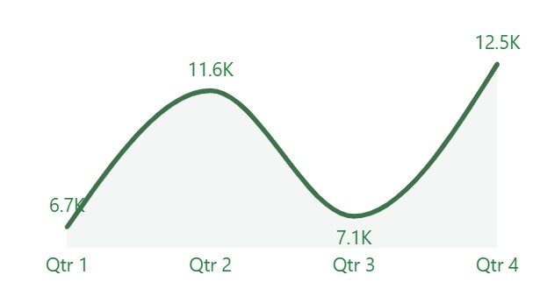
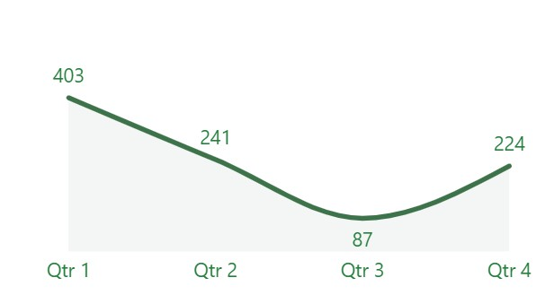

KEY INSIGHT & FINDINGS
Q2 has the highest outreach volume in both years, but very low conversions. Q1 delivers the highest conversion rate, despite lower outreach volume across both years, indicating stronger prospects readiness early in the year.
Outreach Trend
Conversion Trend
RECOMMENDATION
SUCCESS METRIC
- Shift Outreach Volume Earlier in the Year (Q1 Focus):
Shift more outreach efforts to Q1, especially toward students who are most likely to enroll. Even a small increase in outreach during Q1 could lead to much higher enrollment results.
Higher Q1 conversion rate and increased enrollments following increased Q1 outreach activity by at least 10%.
Excelerate can directly control this by adjusting campaign timing, staff allocation, and outreach schedules.

Slide 5
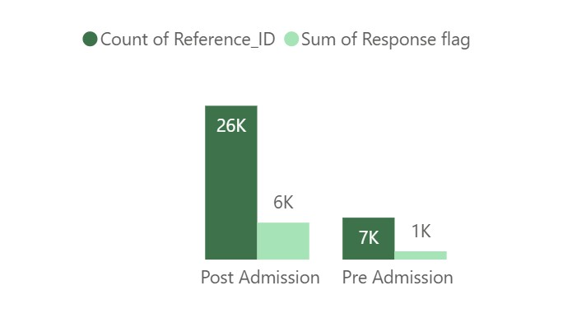
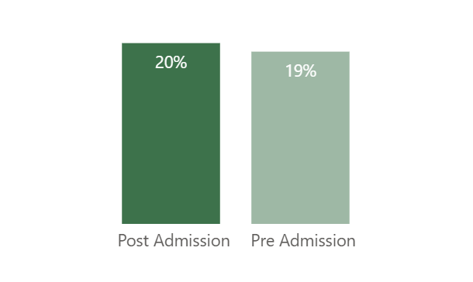

KEY INSIGHT & FINDINGS
Post-Admission campaigns account for the majority of outreach volume (~26K), while Pre-Admission outreach is significantly lower (~7K). However, both segments deliver nearly identical conversion rates (20% vs. 19%), indicating that Pre-Admission is underutilized rather than underperforming.
Conversion Rate
Outreach and Response Comparison
RECOMMENDATION
SUCCESS METRIC
- Increase Pre-Admission outreach efforts and engage students earlier in their decision journey:
This group shows strong potential for enrollment growth, not
poor performance.
Increase in Pre-Admission conversion rate by at least 5%.
Increase in applications originating from Pre-Admission outreach.
Excelerate can directly influence this by refining audience segmentation, prioritizing Pre-Admission campaigns, and adjusting targeting rules to reach high-intent prospects sooner.

Slide 6
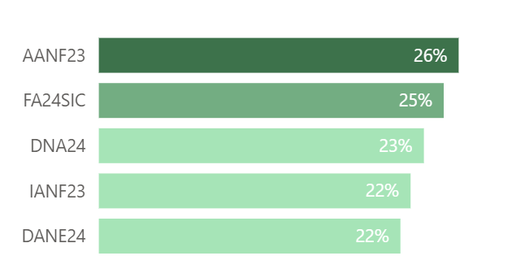
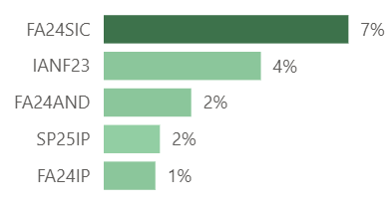

KEY INSIGHT & FINDINGS
AANF23, FA24SIC, and others lead in outreach-to-application ratio (22–26%), meaning they consistently turn outreach volume into applications. FA24SIC and IANF23 also appear among the top campaigns by conversion rate, confirming they are strong performers both in scale and efficiency. Some campaigns show moderate outreach-to-application ratios but very low conversion rates indicating engagement does not always translate into final enrollment.
Outreach to application ratio.
Top outreach campaigns by conversion rates
RECOMMENDATION
SUCCESS METRIC
Replicate strategies from top-performing campaigns (IANF23, FA24SIC) across underperforming ones. This includes messaging, timing, follow-up cadence, and escalation handling.
Introduce structured follow-ups, clearer next-step communication, and earlier escalation for campaigns with high application interest but low conversion.
Shift a portion of outreach resources away from low-conversion campaigns toward those with proven efficiency, while testing improvements on weaker campaigns.
5-15% increase in top and mid-tier campaigns.
5-10% increase in conversion rates.
At least 10% reduction in drop-off across campaigns with historically low conversion.

Slide 7
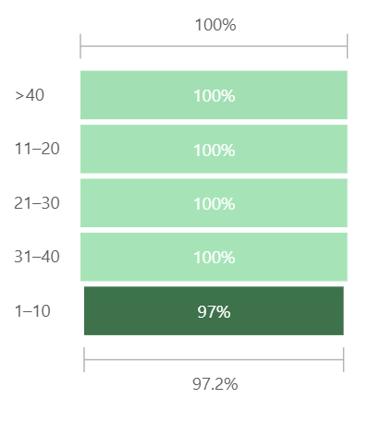

KEY INSIGHT & FINDINGS
Attempts 1–10 show 97% drop-off. Attempts 11+ show 100% drop-off, indicating that the first few attempts matter most.
Repeated contact without strategy is not improving engagement, it’s accelerating disengagement.
Drop-off rate by attempt
Engagement drops sharply after the first 10 contact attempts, showing that early, well-targeted outreach is far more effective than repeated follow-ups.
SUCCESS METRIC
Increase in enrollment rate within the first 1–10 attempts by at least 5%
Reduction in outreach volume beyond 10 attempts
RECOMMENDATION
- Excelerate should cap outreach attempts per prospect at 8–10 touches and shift effort toward improving the quality and timing of early attempts (better messaging, clearer next steps, faster follow- ups). Instead of repeated calls, introduce strategy changes after failed early attempts (e.g., escalation, channel switch, or pause).

Slide 8




FUTURE MONITORING & TESTING
Track Q1 vs Q2 conversion lift monthly to validate outreach reallocation impact.
Monitor Pre-Admission response and conversion rates as outreach volume increases
Continuously review attempt effectiveness to ensure early-touch optimization
Apply messaging cadence, escalation timing, and follow-up structure from AANF23 and FA24SIC to weaker campaigns.
Run A/B tests on messaging, timing, and channels within the first 1–5 attempts
Data Gaps To Address
High NULL values in Country
Inconsistent Outcome Definitions
Limited Visibility Into Channel Mix
Escalation Timing Not Tracked
Campaign Documentation Gaps

Slide 9




Rankings
Findings | Recommendation | Impact Effort | Priority
Campaign outreach to application ratio | Replicate strategies from top-performing campaigns (IANF23, FA24SIC) across underperforming ones. | High | 1
Outreach Trend Overtime | Shift Outreach Volume Earlier in the Year (Q1 Focus) | High | 2
Drop-off rate by attempt | Limit outreach to 8–10 well-planned attempts and prioritize quality over repeated follow-ups. | Medium | 3
Category Response Rate | Increase Pre-Admission outreach efforts and engage students earlier in their decision journey | Medium | 4

Slide 10


Thank You.
Video presentation: https://drive.google.com/file/d/1oQGUvpgTuUx97YrsnX w6_7NLNUy5Vkm1/view?usp=sharing

